Slide 1
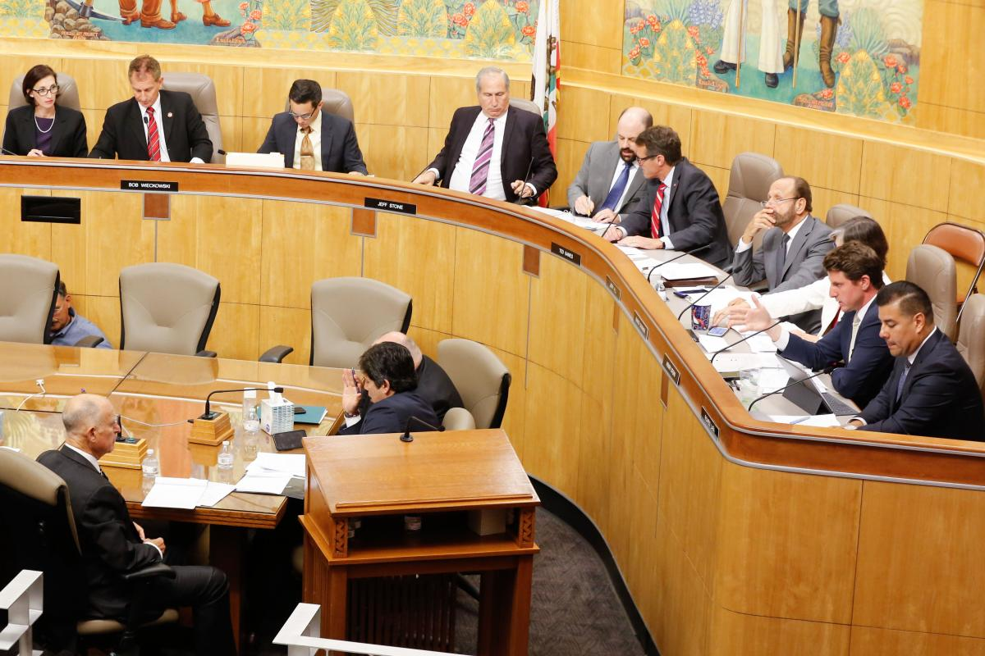
Legislative Process Overview
Presented by
[Full Name]

Slide 2
Public Policy Defined
Local, state, and federal governments have established procedures for creating and modifying public policies, which include laws, regulations, and guiding principles.
Public policy isn't just about legal mandates. It encompasses broader frameworks and guidelines that shape how governments address societal issues.
Policies can be implemented at the local, state, or federal level, depending on the issue and its impact.
While ultimately decided by government officials, public policy is often shaped by advocacy groups and citizen engagement at all levels.

Slide 3
Enacted Legislation Defined
💡
🧾
⚖️
🏛️
👮
📣
Legislative Intent
Written Law
Interpretation
Execution
Enforcement
Education
Initial idea and goals set through the legislator, bill author(s), and sponsoring organizations.
The legally binding code of law as passed by the legislator and signed off by the Executive branch.
How the written law is interpreted may impact it’s execution and any legal actions that follow. Judicial courts may establish changes to the written law based on court proceedings.
A named responsible party or governing body required to enact and rollout the changes. Timelines for execution may be dependent on public awareness and enforcement standards.
A named governing body responsible for creating and conducting reporting procedures, investigation standards, and reasonable follow-up actions to ensure compliance.
Stakeholder advocacy groups engage and inform persons and organizations on their rights and understanding of the law.

Slide 4
Branches of Government
Local, state, and federal government, has three independent Branches:
The Legislative Branch makes the laws and sets the budget. An example of the legislative branch at the local level could be a city council. An example of the legislative branch at the state and federal level includes the Senate and the Assembly, or House of Representatives.
The Executive Branch carries out the laws and manages the budgets. The executive branch includes mayors, governors, and the president, as well as cabinet members.
The Judicial Branch interprets the law and resolves disputes. The judicial branch includes courts at all levels of government, including Municipal Courts, State Courts, Federal Courts, and the Supreme Court.

Slide 5
Overview of Local Lawmaking
Municipal governments, typically encompassing towns, cities, and counties, play a crucial role in shaping our everyday lives
Basic Services: Maintaining infrastructure, public safety, public health, and waste management
Quality of Life: Parks and recreation, education, libraries, zoning and land use
Local Policy and Regulation: Enacting local ordinances, budgeting and finance, and community development
Lawmaking processes will vary from one municipality to the next, but one thing is usually consistent—many locally elected officials have more direct contact with their constituents

Slide 6
Overview of State Lawmaking
State legislatures are active players in the day-to-day governing of the country. In fact, state legislatures on average pass 80 state bills for every 1 federal bill that Congress enacts.
State legislatures are responsible for raising enormous amounts of money through state tax revenue and coming up with new solutions to tackle complex public problems.
California State Legislature is made up of two houses:
Senate - 40 Senators
Assembly - 80 Assemblymembers
The California Legislature has a two-year session

Slide 7
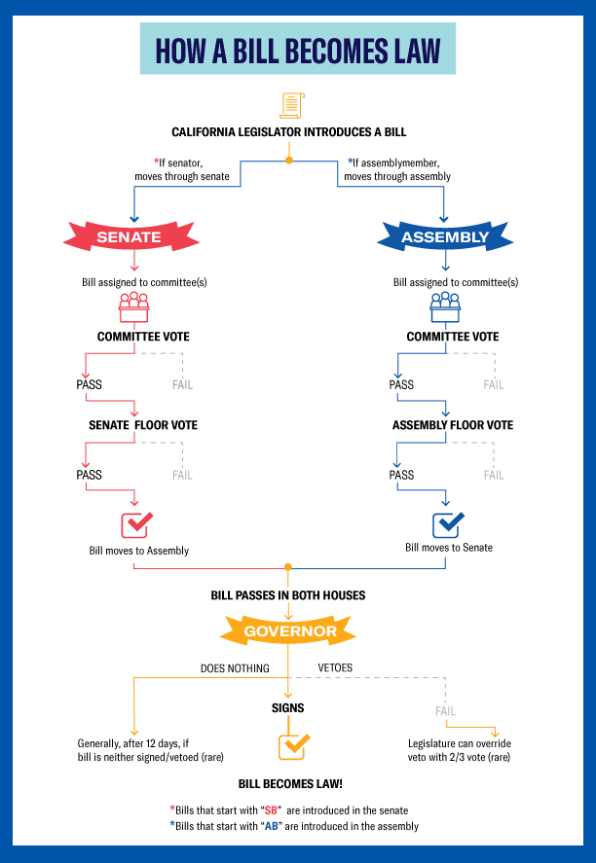
Simplified Overview of the State Lawmaking
Process
Source: https://capitolmuseum.ca.gov

Slide 8
Overview of Federal Lawmaking
The United States Congress is responsible for passing federal legislation and appropriating funds for federal and many state programs.
The US Congress has 2 chambers—the Senate and the House of Representatives.
Each chamber has its own leadership, its own committee structure, and its own set of rules. Senators serve 6 year terms and Representatives serve 2 year terms.
Each state has 2 Senators representing the entire state. The number of Representatives for each state depends upon the state’s population. This number may change every 10 years when the US Census is taken.

Slide 9
How A Bill Becomes Law
Whether you are working at the local, state, or federal level, each decision-making body has a process they go through to take an idea and turn it into a law.
The process will differ somewhat by state or municipality.
Regardless of the exact process used in your city, county, or state, the important thing to know is where you can influence the process by sharing your perspective, story, and experience.

Slide 10
Let’s Play a Game!
“The Longest-Running Game in Town”
Find the printed game board and dice on your table
Select playing markers (a coin or pen cap will do)
Any number of players may play at your table
The game begins with each player choosing a topic and offering a bill for introduction

Slide 11
Making a Difference
You don’t have to be a legislative expert to effect change.
Decision-makers are generalists and need to hear from people with insight or expertise.
Opportune times to weigh-in:
During Committee hearings
Before key votes
During the budget process—when budget is being created by Executive Branch and when being adopted by Legislative Branch
Before a bill reaches the Governor’s desk

Slide 13
Thank You!
Sr. Delegate: Name
Email: your@email.com | Phone: ###-###-####
Jr. Delegate: Name
Email: your@email.com | Phone: ###-###-####

