Slide 1
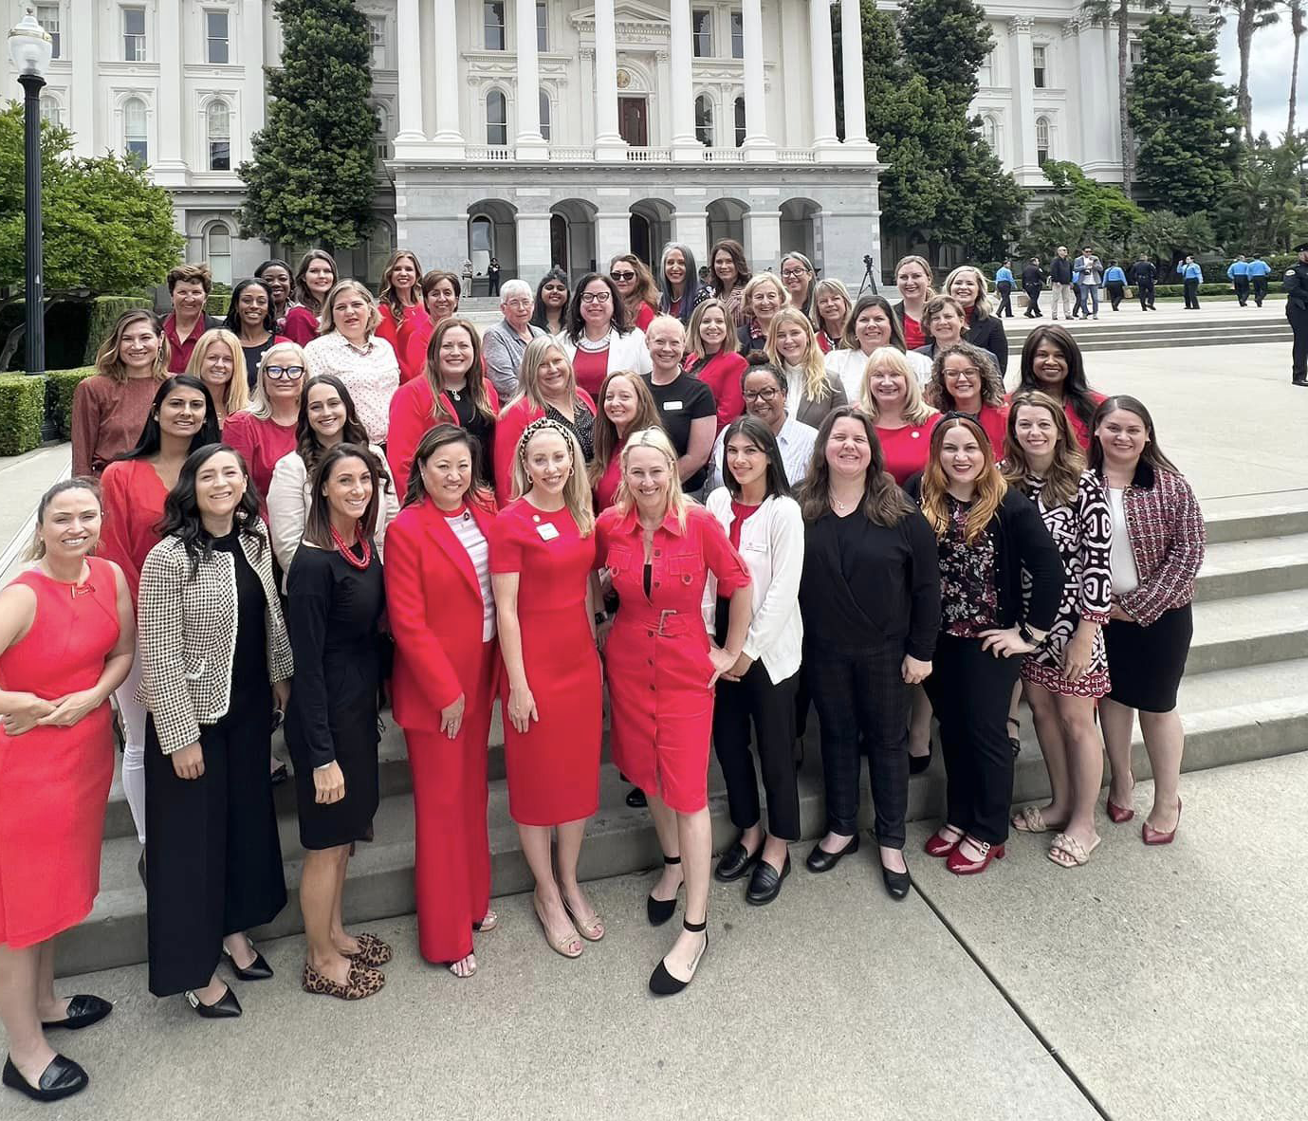
CalSPAC Overview
Presented by
[Full Name]

Slide 2
“Leadership is about making others better as a result of your presence and making sure that impact lasts in your absence."
Sheryl Sandberg

Slide 3
What is SPAC?
A State Public Affairs Committee (SPAC) is an invention of The Junior League that has been around since the 1930s. SPACs were developed in order to influence public policy on specific issues within a particular geographic area, such as a state, a county, or a city.
The purpose of CalSPAC is to take action on select policy issues that support our projects, mission, focus areas and/or position statements, to educate Junior League members on issues selected for action by CalSPAC, to facilitate communication among the member Junior Leagues of California in the areas of public affairs, to provide training in advocacy skills and strategies and to act as the representative of the member Leagues of CalSPAC at state and national levels.

Slide 4
California State Public Affairs Committee
Founded in 1971 to serve as the collective voice for all 17 California-based Junior Leagues engaging in:
Advocacy: General awareness and coalition building based on focus areas
Lobbying: Direct ask for support, action, or a vote regarding legislation
Training: Empower Delegates and Home League members to advocate and lead in their communities

Slide 5
CalSPAC Purpose & Structure
Our Policy Objectives are Aligned with Home League Missions, Programming, and Issue Areas
Federal law protects our right to advocate and lobby
We are a Non-Partisan Organization
We do not endorse a particular candidate or political party
We represent 17 member Junior Leagues across California comprised of approx. 6,500 women volunteers
All CalSPAC Delegates and Leaders are Volunteers

Slide 6
CalSPAC Collective Impact
Health
Our Delegation guides our organization and our Home League policy objectives
We have 5 Focus Areas (also called Legislative Priorities)
Each comes with it’s own position statement
Education
Family Support
Violence Prevention
Anti-Human Trafficking

Slide 7
Health Position Statement
CalSPAC supports policies and initiatives that improve access to quality healthcare and prevention programs aimed at the improvement of mental and physical health in communities around California.

Slide 8
Education Position Statement
CalSPAC is committed to the boundless potential of California’s youth and works to ensure their access to educational opportunities that are developmentally appropriate, that increase achievement, and lead to workplace marketability.

Slide 9
Family Support Position Statement
CalSPAC believes that there is a critical need for attention to the needs of all California families and advances programs and policies that promote their physical and emotional engagement and well-being.

Slide 10
Violence Prevention Position Statement
CalSPAC seeks to increase awareness of the impact of violence in California communities and champions policies that strive to decrease violence through prevention, intervention, and education.

Slide 11
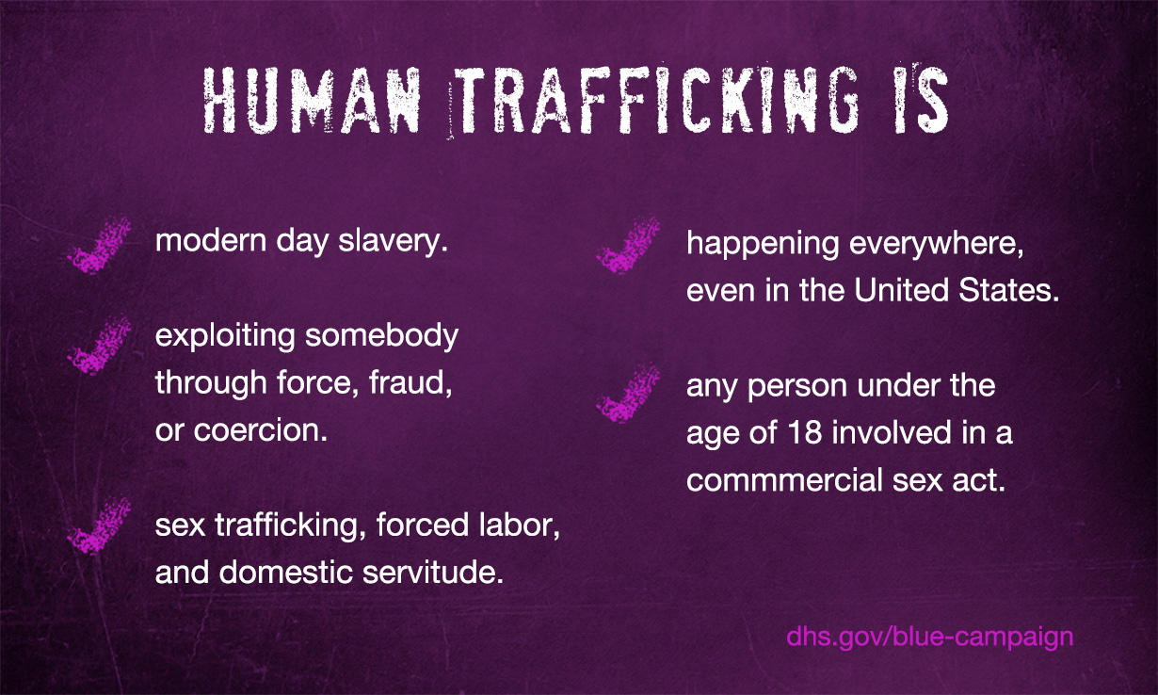
Anti-Human Trafficking Position Statement
CalSPAC addresses the issue of human trafficking in all its forms, advancing policies that prevent trafficking, prosecute traffickers, and protect victims.

Slide 12
Follow our Happenings on
Our Website: www.CalSPAC.org
Our Bill Sponsorship Tracker: www.CalSPACTracker.org
Our Social Media Pages (click to follow and tag our pages!):
Facebook @JLCalSPAC | www.facebook.com/JLCalSPAC
Instagram @JLCalSPAC | www.instagram.com/JLCalSPAC
LinkedIn @CalSPAC | www.linkedin.com/company/CalSPAC
Twitter @CalSPAC | www.twitter.com/CalSPAC

Slide 14
Thank You!
Sr. Delegate: Name
Email: your@email.com | Phone: ###-###-####
Jr. Delegate: Name
Email: your@email.com | Phone: ###-###-####

